Slide 1

Predicting Steam Ratings
Kyle Rodrigues, Stuart Harley, Matt Haas
Notes:
Link to Colab: https://colab.research.google.com/drive/1dTwZV_upgBWKkPCyqzmUct9vJrUrIIGM?usp=sharing

Slide 2

What is Steam?
Video game distribution service

Slide 3

Why Choose this Steam Dataset?
Since we all use Steam, we thought that analyzing games on Steam would be a fun and interesting project
Dataset is from Kaggle that was gathered around May 2019 from the Steam Store using SteamSpy API’s

Slide 4

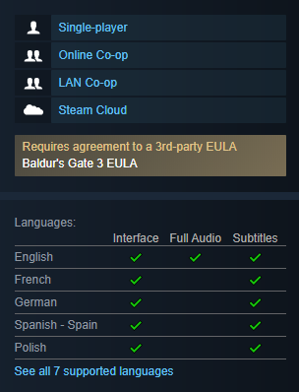

How the Data was Retrieved

Slide 5
How the Data was Retrieved
Output

Slide 6
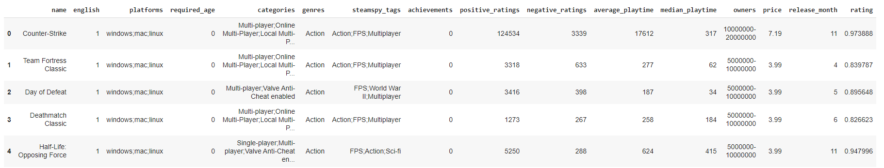
Investigating Dataset - Looking at Features
Note that we have excluded the following features that we did not want to analyze:
release date
Engineered release month, which was statistically significant with our data
appid
essentially just a index to represent row number
developer and publisher
too many unique values to make it a usable categorical variable

Slide 7
Research Questions
Hypothesis
Based on the statistics for a game on Steam, can we create a model that can determine that game’s rating?
Can we predict the rating of a game based on features known at publishing?
If we can find features from the games that are statistically significant with the games rating, then we can create a model that determine a game’s rating based on the statistically significant features.

Slide 8
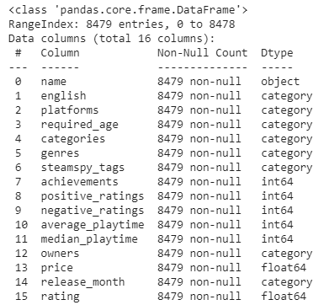
Dataset Preprocessing
Dataset went from 27,075 to 8,479 rows

Slide 9
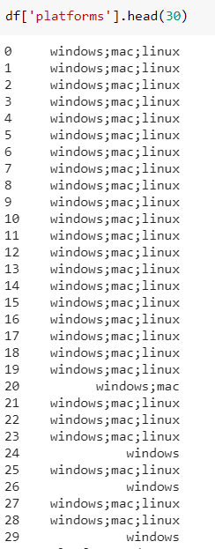
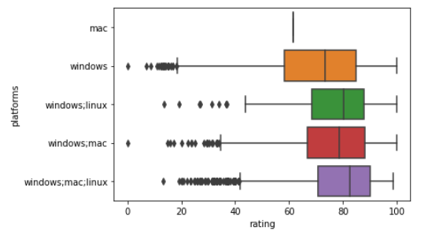
Dataset Analysis - Categorical Features
Kruskal-Wallis test to compare categorical features with numeric rating
Visualization showed a major flaw in our approach
categories, genres, and steamspy_tags had too many unique values and boxplots were not readable
Our data needed to be preprocessed more to break up certain feature values
platform
windows
windows;mac
mac;linux
Etc…

Slide 10
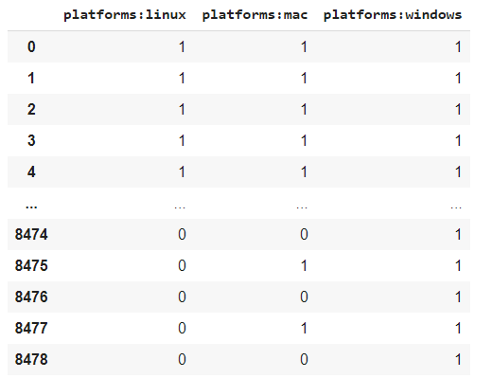
Dataset Analysis - Categorical Features
Solutions
Use one hot encoding to split up categorical variables (if applicable)
Remove duplicate values (otherwise we would have features with high cardinality)
platform: linux;windows, mac;windows → linux, windows, mac
steamspy_tags: Action;FPS, FPS;Sci-fi → Action, FPS, Sci-fi
Assess if separate variables are still statistically significant from one hot encoding

Slide 11
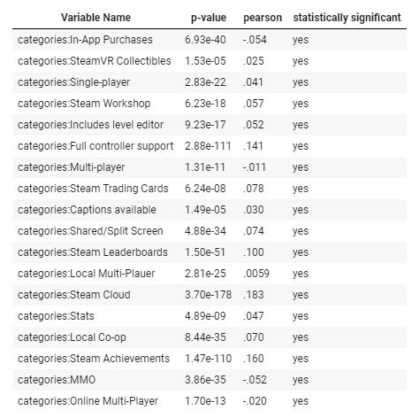
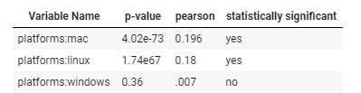
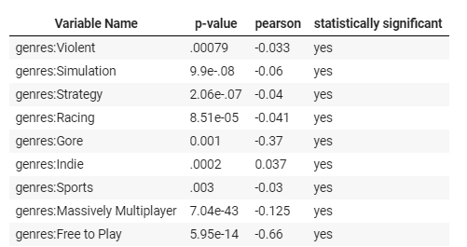
Categorical Variables Analysis - Kruskal-Wallis Test
Notes:
Only showing chosen variables. There are omissions, genres has 29 or so unique values, same for

Slide 12
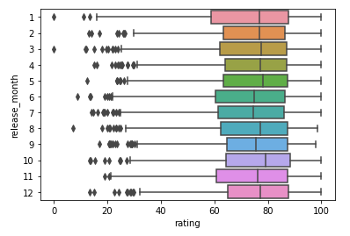
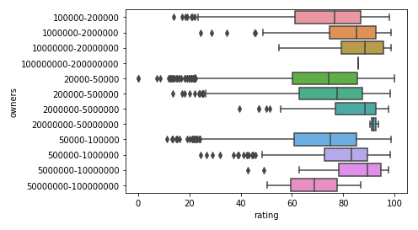
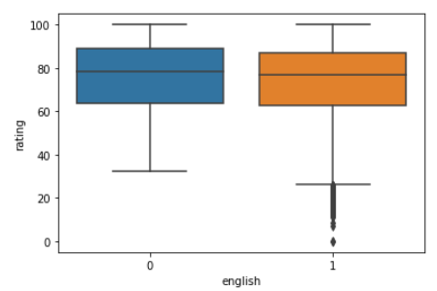
Dataset Visualization - Categorical Features

Slide 13
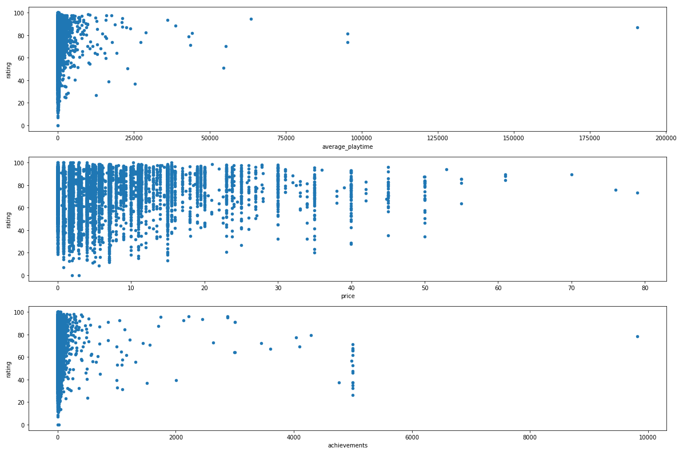
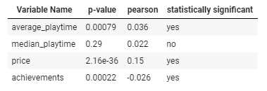
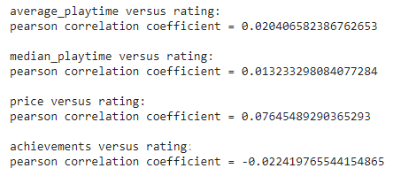
Dataset Visualization - Numerical Features
Linear Regression to compare numerical features with rating
Notes:
Most of the time went to data engineering categorical variables.
You can see a little bit of correlation between increasing numeric variables and the rating, but not much
While the correlation is significant, the pearson correlation and visualizations shows that the correlation is minimal with little to no relationship

Slide 14
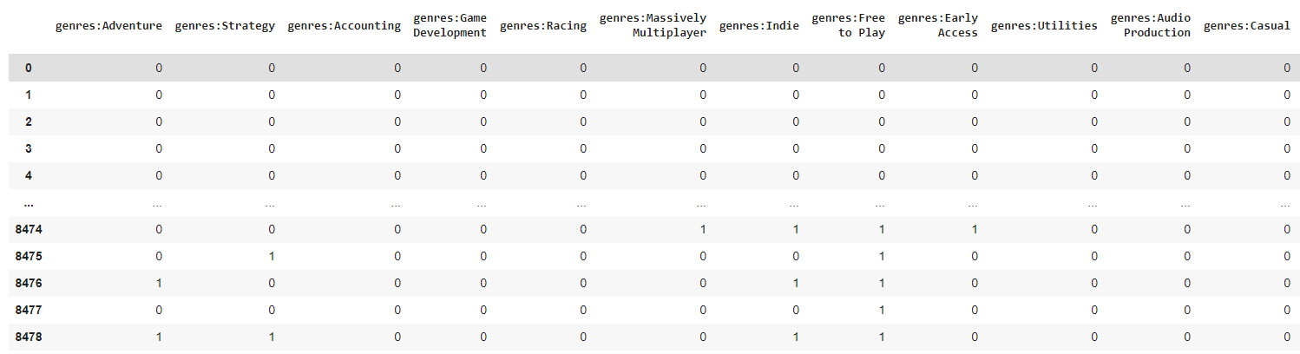
Additional Preprocessing - One Hot Encoding
genre
categories
owners
required_age
steamspy_tags
platforms
6 features → 380 features
High cardinality in our feature space with categorical variables

Slide 15
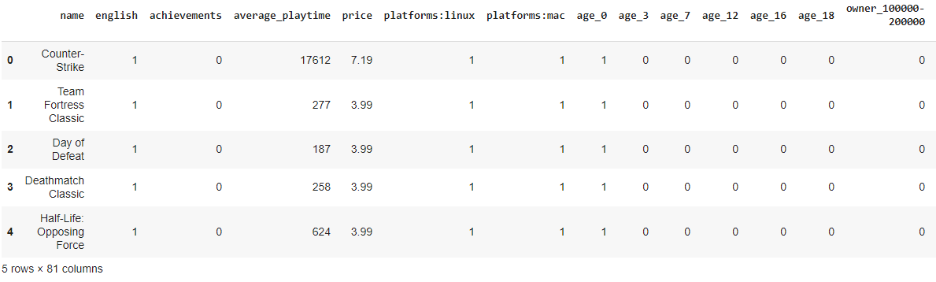
Data Preprocessing - Reduce
Reduced 380 features → 75 one-hot features + 4 numeric features + name + rating
Notes:
Use only statistically significant features

Slide 16
Model
Supervised Learning
Regression Problem
Models Used
Linear Regression
Limited to linear relationships
Support Vector Machine
Doesn’t perform well if data has a lot of noise
Random Forest
Doesn’t perform well with one-hot encodings with lot of levels
Experimental Idea
Testing different types of variables to predict rating and see results
Experiments
Combining statistically significant categorical and numerical variables
Predictive features known at publishing
Small subset of best performing features

Slide 17
Preparing the Models and Evaluating
Scaling
Used Standard Scalar
Train Test Split
Used a test size of 30%
Evaluate model output with MSE and MAE
MSE is mainly used for comparison between models. Penalizes larger errors.
MAE is a better representation of the accuracy of our model results.
ex) 12 MAE means that on average, our predictions were off by 12 rating.
Since we are rating from 0-100, corresponds to 12%

Slide 18
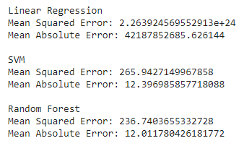
Experiment 1 - All Numeric and Categorical Variables
RF/SVM performed the best of all experiments, but difference was negligible
Linear Regression failed for some reason in this experiment

Slide 19
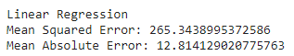
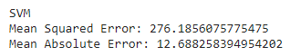
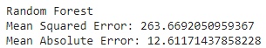
Experiment 2 - All Variables Known at Publishing Time
All models were roughly the same. Linear Regression worked here.
Slightly worse errors than Experiment 1

Slide 20
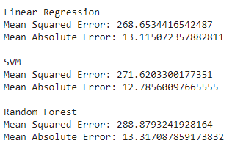
Experiment 3 - The Best Features known at Publishing
Top statistically significant features based on pearson correlation coefficients
Slightly worse than Experiment 2 - but a lot less complex
79 features from experiment 1 down to 14

Slide 21
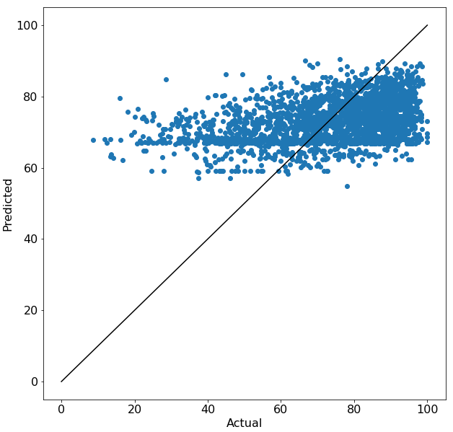
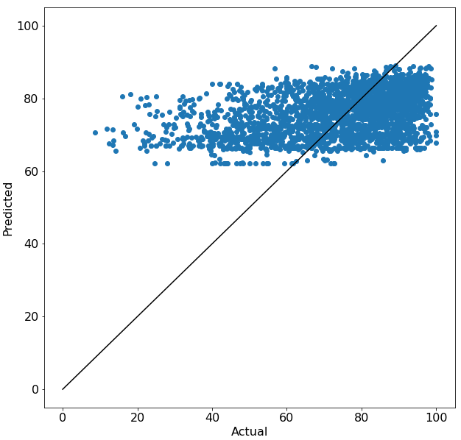
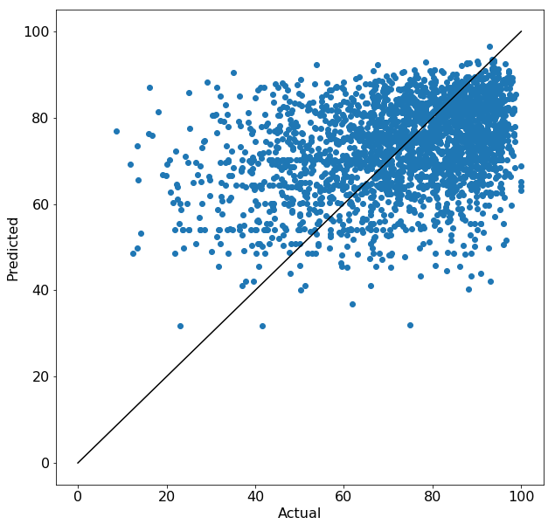
Line of Identities from Models’ Predictions
Linear Regression
SVM
Random Forest

Slide 22
Conclusions
Hypothesis Results
Looking at MAE, (~13%), seems like it is possible to semi-accurately predict a game’s rating
However, when looking at plots of results, cannot say that our model can predict well
Possible reason why - Game ratings are based on quality of gameplay, feel of the game, storyline, etc. which are not represented in this dataset
Analysis on Model Results
Was not significant difference of model performance based on model type
Experiment 1, using all features, only slightly outperformed the other experiments
Experiment 3 was less complex with only features that are known at publishing time and has minimal decrease in performance
Learnings
Lot of time spent going back to preprocessing data due to catching outliers during the modeling stage
Understanding our data/domain better in the beginning would have saved a lot of time

Slide 23
Future Steps
Scrape recent data and try to apply the model to it
Apply model to games in beta and try to determine a games rating in the future based on a time function
May not be worthwhile seeing as our model did not perform well

